Slide 1
The Stewardship of Information at ESDC

Slide 2
Purpose
To engage all ESDC employees on:
Our commitment as stewards of Departmental information assets;
Employee accountability for the protection of privacy and the safeguarding of sensitive and personal information;
The proper classification and handling of information; and
The fundamentals of Information Management.

Slide 3
The Stewardship of Information at ESDC: Why it Matters
The responsible management and protection of information under ESDC’s control is fundamental to everything we do:
The development of policies that make Canada a society in which everyone can use their talents, skills and resources;
The creation of programs and support initiatives that help Canadians move through life’s transitions—from families with children to seniors, from school to work, from one job to another, from unemployment to employment, from the workforce to retirement;
The delivery of services through Service Canada and other partners;
Analysis, research, audit, and evaluation of our activities to support the effectiveness of our programs and services; and
Services to support HRSDC employees to establish a healthy work environment and nurture an organizational culture that is consistent with public service values and ethics.
As a result of our mandate, ESDC manages more personal information on Canadian citizens than any other organization in Canada.
Everyday, thousands of ESDC employees work directly with the personal information of our clients and employees at hundreds of locations across Canada.

Slide 4
The Stewardship of Departmental Information Assets
The stewardship of information assets is multi-dimensional…
Privacy
The protection of personal information
Values and Ethics
Information Management
A principled and ethical approach to information protection as an organizational value
Stewardship of Information Assets
Management of information resources of business value
Security
Information Technology
The safeguarding
of information,
assets and services via people, processes, and
technology
Infrastructure to store and retrieve information
…and it is the responsibility of every employee.

Slide 5
The Stewardship of Information: A Values and Ethics Perspective
Values and Ethics
The stewardship of information and the protection of privacy are key components of ESDC’s Code of Conduct:
As an employee of the Department, you are responsible for the safekeeping of information that you collect, handle, store or transmit. You are also responsible for ensuring proper disposal. Whether the information is in an electronic, paper, or other format, it is your responsibility to ensure that it is only seen or handled by those who have the right to see it.
You are permitted to access only the personal information that is necessary for your work.
A client's personal information may only be disclosed as legally authorized.
The Privacy Act gives Canadians the right to see their own personal information, except in certain circumstances, in records that are under ESDC’s control.
In addition, there is a complex array of Government of Canada and Departmental policies and directives that provide direction on the proper management and protection of information:
Information Management
Privacy
Security
IT security
A breach of the Code of Conduct or any of the related laws, policies or procedures may lead to administrative or disciplinary measures being taken, up to and including termination of employment.

Slide 6
The Privacy Act, the Privacy Codes, and Personal Information
Privacy
The Privacy Act imposes obligations to respect privacy rights by limiting the personal information that we collect, use, and disclose. This applies to all personal information under our control, including employee personal information.
The Privacy Code found in our Departmental legislation include additional provisions for the use and making available of personal information by ESDC. The requirements in the Privacy Code exceed the requirements set out in the Privacy Act.
Section 3 of the Privacy Act defines personal information as information about an identifiable individual that is recorded in any form, including:
race, national/ethnic origin, colour, religion, age, marital status
education, medical, employment or criminal history
identifying number, symbol or other particular assigned to an individual (i.e. Social Insurance Numbers, bank account numbers etc.)
address, fingerprints, blood type
personal opinions or views (unless they are about someone else, are about a proposal for a grant, award or a prize being given/awarded to someone else)
private or confidential correspondence and replies to that correspondence
the name of an individual when it reveals information about the individual

Slide 7
The Privacy Act and Personal Information, cont’d
Privacy
Other types of personal information about identifiable individuals, includes:
information concerning sexual preference
information concerning political affiliation
information about an individual’s personal likes and dislikes (unless those likes and dislikes are about someone else, then a comment such as “I don’t like Sue because she is mean” is personal information about Sue, not of the person who made the remark)
There are other types of information that are specifically excluded from the definition of personal information for the purposes of the Privacy Act:
work-related information about current and former federal public servants, (i.e. title, business address and telephone number, classification, salary range, responsibilities, etc.)
details of contracts between individuals and the government
details of discretionary financial benefits provided by the federal government
information about individuals who have been dead more than 20 years

Slide 8
The Essentials of Privacy Protection: What you need to know
Privacy
All ESDC employees have a role to play in protecting the personal information of Canadians. Each employee has a duty to protect personal and sensitive information under their custody and control.
Personal information that we collect must be limited to information that is directly related to the operation of Departmental programs or activities.
At the time of collection, we have an obligation to explain to our clients, in plain language, why and what personal information is collected, how it will be used, and with whom we may share it.
When we plan to use personal information that has already been collected for a new purpose, we are required to identify the new use. If this new purpose is not consistent or required by law, the consent of the individual is required.
Personal information cannot be used or disclosed for purposes other than those for which it was collected, unless the individual provides consent or where there is legal authority.
The Privacy Act gives individuals a right of access to information about themselves and to request the correction of their personal information held by federal government organizations.
Personal information must be held long enough to allow individuals to access their information after decisions using that information have been made. Personal information that is no longer required is to be disposed in accordance with law and policy.

Slide 9
The Classification of Information: What you need to know
Security
ESDC manages a wide range of information that is defined as Protected, Classified, or Unclassified:
“Protected” information refers to specific types of information identified in the Access to Information Act and the Privacy Act and includes sensitive personal, private, and business information.
“Classified” information relates to the national interest. It concerns the defence and maintenance of the social, political, and economic stability of Canada.
PROTECTED INFORMAITON
Protected C Threat to Private, non-national interests | Top Secret Grave Injury to National Interest
Protected B Particularly sensitive, serious injury to individuals May contain information on program eligibility, medical, financial information, etc. | Secret Serious Injury to National Interests
Protected A Low sensitivity; limited injury to individuals Contains one of: Name, Address, Gender, SIN, etc. | Confidential Injury to National Interest
Unclassified (Public) Information
CLASSIFIED INFORMATION

Slide 10
A Closer Look: Protected B and Secret Information
Security
PROTECTED B information can cause serious harm if inappropriately disclosed:
Documents containing more than one personal information element
Can be created and stored on the network
Store in locked cabinets, ESDC-approved electronic system, or encrypted USB in a locked cabinet
Transported, mailed or couriered in a sealed double envelope
Can be emailed on ESDC systems within the departmental firewall, using encryption depending on sensitivity
Can only be faxed using a secure fax – Don’t fax unless you know it is secure
SECRET information can cause serous injury to the national interest (e.g., Memoranda to Cabinet, Cabinet records, Treasury Board submissions)
Must be created and stored on an encrypted USB key
Controlled distribution (i.e., numbered copies, signatures for receipt)
Use only in Secure Zone office space. Store in an Regional Security Office (RSO) approved locked container or ESDC-approved encrypted USB key in a locked security container
Transport or reliable courier in a double-sealed envelope. Consult RSO
Do not email. Consult RSO on secure transmission
Must be carried in a locked RCMP approved briefcase, which, if transported in a car, must be stored in the trunk of the car
For more information, consult the Departmental Security Policy and Procedures Manual and the Information Classification Guide.

Slide 11
Safeguarding Personal Information
Security
We must protect and carefully keep in strict confidence all of the personal information under our custody and control.
Access to personal information must be restricted on a “need-to-know” basis.
All personal information, in all forms and formats, must be protected against loss, theft and unauthorized disclosure, copying, use and modification.
Procurement documents and grant and contribution agreements must contain clauses for the confidentiality and the physical and technical security of personal information.
We all have a duty to immediately report any incidents of improper or accidental use, disclosure or loss of personal information to our immediate supervisor.
Be proactive in identifying privacy risks to supervisors and seek advice to improve the secure handling of personal information.
If you have any questions, ask your supervisor!

Slide 12
Managing Information Securely: The Basics
Security
All employees are responsible for the secure handling of information that is under their custody and control.
Depending on the classification of documents, employees must:
Identify sensitive information and have it marked accordingly;
Choose a location and equipment that is secure for compiling, discussing and transmitting the information to others;
Follow the Department’s procedures for secure transportation or transmission;
Store information securely (electronically and physically);
Dispose of information safely and securely;
Respect the need-to-know principle; and
When sharing sensitive information with other departments, governments, organizations or recipients, ensure there are written agreements and protocols in place regarding the management and treatment of the information.
When collecting sensitive information, employees and contractors must have a valid security screening at the appropriate level.
Regularly review and update IT system and drive accesses, permissions, delegations, passwords and user profiles and distribution lists, as applicable.

Slide 13
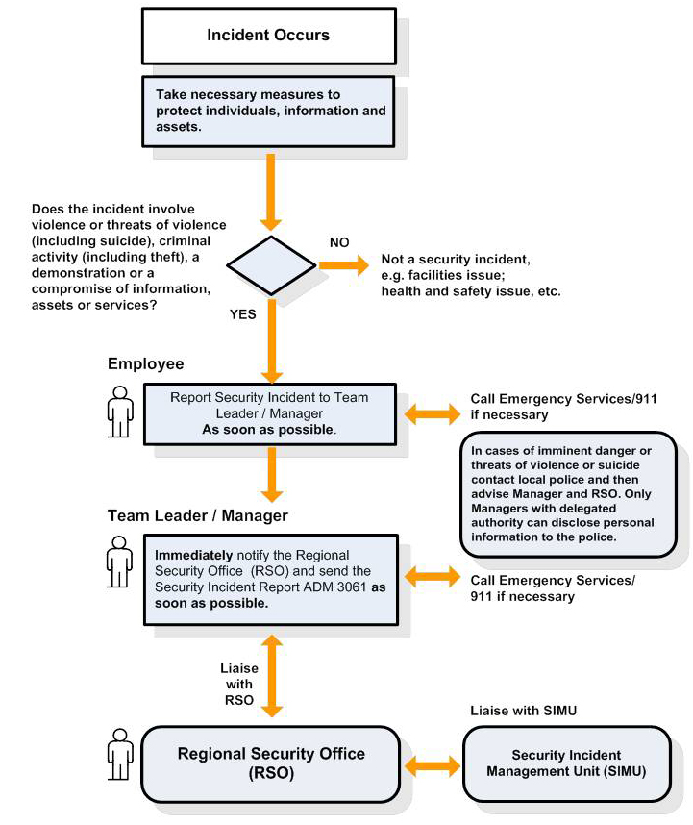
Process for Reporting Security Incidents
Security

Slide 14
USB Storage Devices Directive: What you need to know
Information Technology
On January 10, 2013, ESDC introduced a new USB (Universal Serial Bus) Storage Device Directive to:
Enhance the safeguarding of data that resides within the department’s responsibility;
Ensure that where data needs to be transferred or shared for business purposes, appropriate tools are employed which mitigate the risk of loss or unauthorized access; and
Reduce or eliminate losses of information that may result in injury to citizens’ personal or financial integrity, damage to Departmental applications or technology, and/or loss of confidence in the Department’s ability to responsibly manage citizens’ private information.
There are two types of departmentally-procured and issued USB keys are approved for use: biometric and password protect encrypted USB keys.
USB keys are now centrally procured by IITB and distributed by the DSO.
Unauthorized USB keys and portable hard drives are not to be connected to the network. Any USB storage technology not otherwise referred to in this directive can only be installed and/or procured at the discretion of and with the prior approval of the CIO or his delegate.
It is forbidden to connect personal equipment or devices to the network.
IITB will regularly monitor and report on USB devices connected to the network. Unauthorized devices will be reported to both the DSO and the responsible ADM so that appropriate steps can be taken.

Slide 15
The Importance of Information Management
Information Management
Good Information Management practices are critical to privacy and security:
KNOW the difference between Information Resources of Business Value (IRBV) and transitory information.
STORE information consistently by using the same classification structure in your shared drive space and your email inbox.
BE CONSISTENT when naming your electronic files – especially when others will have access to them.
MANAGE your emails by regularly deleting messages that have outlived their usefulness.
SEND links within emails instead of attachments whenever possible.
KNOW your IM roles and responsibilities.
MAKE your information easily accessible (keep in mind that certain information must be protected).
ENSURE that your information is transferred to another employee or to the appropriate repository when changing jobs.
REMEMBER your obligations under the Access to Information and Privacy Act.
CONSULT the Information Management resources often (IMS Intranet site, IM specialist).

Slide 16
Your IM Roles and Responsibilities
Information Management
According to the Treasury Board Secretariat (TBS), ALL employees have the following IM responsibilities:
What TBS Says: | What It Means:
6.3.1 applying GC and departmental information management policy, standards, procedures, directives, guidelines, tools and best practices in a way that supports their department's business, as implemented in their department; | Regularly take inventory of your information resources Identify which of the information resources have business value (IRBV) Regularly delete transitory information in your possession Manage your email inbox Use consistent naming conventions and mirror your branch classification structure (Shared Drive) Regularly assess and properly dispose of IRBVs without archival value once they have reached their disposition date
6.3.2 documenting their activities and decisions; | Keep information (email, summaries, drafts with comments) that support a decision made in regards to an IRBV
6.3.3 providing and bringing to their manager's attention information requirements and issues and, when appropriate, to information management functional specialists; | Bring your IM concerns (areas where you feel IM needs a stronger presence) or IM questions to your Manager (work, training, awareness, etc.)
6.3.4 treating departmental information in a manner that facilitates access while ensuring privacy and security requirements are met. | Regularly save IRBVs, for which you are the owner, into a corporate repository (Shared Drive) to share the information as widely as possible (keeping in mind to restrict access, if need be, according to privacy concerns)

Slide 17
Your IM Roles and Responsibilities: Tools Available
Information Management
Messaging: Be mindful of how you manage information to reduce the risk of security and privacy breaches. Avoid information hoarding and follow the information lifecycle.
Products/Events | Training
Read IM articles in IITB News and Intersection Visit the Information Management Blog monthly Promote IM Banners Consult One-pagers Email Management IM Top10 Best Practices Keep it! Chuck it! Top 10 IM Rules prior to Retirement or Departure Disposition of Electronic IRBVs Participate in IM Days and encourage Branch/Regional IM Days | Canada School for Public Service: Information Management-Personal Awareness and Capacity Test (IM-PACT) (I004E) Recordkeeping for Public Servants (I002E) Fundamentals of Recordkeeping (I003E) HRSDC: Recordology Tutorial CDS Tutorial What’s New in IM IRBV Training Retention and Disposition
To request an HRSDC training session, open a ticket with the NSD and indicate that it is for “IM Training”.

Slide 18
Key Takeaways
ESDC is committed to meeting the highest standards of respect for the privacy rights of Canadians and the protection of their personal information. This commitment is critical to maintain the trust of Canadians.
The stewardship of information is everyone’s business. Every employee in the Department has a role to play in the proper handling and protection of information.

