Slide 1
ESDC Workplace-based Mental Health
Peer Support Program
Notes:
The purpose of this presentation is to introduce you to the ESDC Peer Support Program (PSP)
The PSP is one of the activities included in ESDC's Integrated Mental Health Framework, which aims to promote workplace health and psychological safety and encourage employees and managers to openly address mental health concerns.
If you are interested in learning more about the ESDC’s Integrated Mental Health Framework, I invite you to visit the Workplace Mental Health web page available on iService.

Slide 2

THE PEER SUPPORT PROGRAM (PSP)
  A confidential, voluntary, non-clinical mental health support service for all employees in the organization.
  Objective :
  Support and empower employees coping with
  mental health issues.
Notes:
The objective of the Peer Support Program is to support and empower employees coping with mental health issues, either personally or through a loved one, to find their own path to recovery.
Peer support is the use of the lived experience of a mental health situation to help others who are going through similar situations by providing social and emotional support.
The program is confidential, voluntary and non-clinical for all departmental employees -Anyone in the organization can take advantage of ESDC's Workplace Mental Health Peer Support Program: students, casual, term and indeterminate employees, regardless of their group and level, whether they are present at work or absent on leave with or without pay.
It is a complement to, not a replacement for, professional medical and clinical care services.

Slide 3

WHAT IS A PEER SUPPORTER?
  An ESDC employee who :
  Has been through a mental health situation and is now in a positive state of recovery and/or readiness;
  Volunteers to support fellow ESDC employees;
  Successfully completed the mandatory Peer
  Support training.
Notes:
This is a person who has acquired experience either by:
suffering from a mental health problem and has been successful in coping and/or
provide daily support to a family member or loved one with mental health issues.
It is an employee who volunteers to support ESDC colleagues;
He was selected through a departmental selection process and successfully completed the mandatory peer support training.
When you choose to enter into a relationship with a peer supporter, you have access to a private and confidential relationship based on the support and understanding of a peer who has experienced a similar experience.
The peer supporter listens without judgment and uses his or her personal experience and skills to help overcome our difficulties.
It provides a sense of comfort and encouragement.
A peer support interaction may take place during breaks and lunch times, and if necessary, before or after office hours / depending on the availability of Peer Supporter and the employee. Although some discussions may take place during working hours, this must be done reasonably.
Note:
If you are a Peer Supporter and make the presentation, mention why you are involved in the Peer Support Program.
I am involved as a Peer Supporter because ... Add why you became a Peer Supporter, how such a caring relationship would have helped you overcome a mental health situation .... Mini-testimony (+ - 3 minutes)

Slide 4

WHY TURN TO A PEER SUPPORTER?
Because:
  You feel like sharing in a safe space, where you feel heard, without judgment, and free to discuss issues occurring in your life;
  you feel overwhelmed;
  you observe changes in your mood and
  behaviours as described in the Mental Health
  Continuum.
Notes:
Mental health means striking a balance in all aspects of your life. At times, you may tip the balance too much in one direction and have to find your footing again. Your personal balance will be unique, and your challenge will be to stay mentally healthy by keeping that balance.
It is possible to take action at any time to return to a more functional state of health.
Life’s circumstances can affect you and bring a mental health problem (separation/divorce; severe workplace stress or conflict; loss of a loved one, etc.)
Click on the Mental Health Continuum link.
The Mental Health Continuum is a self-awareness tool that allows each person to quickly assess their level of well-being and find effective strategies to stay healthy or improve their health.
The continuum describes 4 different stages between the two extremes: healthy and ill.
Our position in the continuum can change with time (days, weeks, months) or because of life’s circumstances. It’s like a juggler with many balls, each ball represents an aspect of your life.
When you are in green, everything goes well and the balls are going at a steady pace.
When you are in yellow, the rhythm is uneven but the balls stay in the air
When you are in orange, a ball falls
When you are in red … several balls fall to the ground.
The continuum can help you identify the signs of good and poor mental health, and find strategies to stay healthy or return to good health.
The sooner you act, the better!

Slide 5
SOME OF THE BENEFITS
Here are a few key benefits that you may experience receiving peer support:
  Feeling of social connectedness.
  Decrease feeling of loss of control.
  Realising that what you are experiencing is not unique and that there is hope for recovery.
  Develop a renewed narrative to explain (to co workers and supervisor) what you are challenged with.
  Increase self confidence.
  * References available on request
Notes:
When using a moisturizer for facial care, we expect different benefits such as protecting our skin, preventing signs of aging, having a more radiant complexion, etc...
When you exercise, the benefits are:
Reducing the risk of heart attack
Decrease in blood pressure
Better weight control, energy level, etc...
Here are some of the benefits you may gain from interacting with a peer supporter

Slide 6
STRICTLY CONFIDENTIAL
Confidentiality is the cornerstone of the Program!
Confidential conversation in complete privacy.
Strict Peer Support Conduct Guidelines.
  Clear expectations and responsibilities regarding confidentiality;
  Compliance with ESDC's privacy policies.
Application Control by the Peer Support Program Management Office under the Human Resources Services Branch.
Notes:
Confidentiality is essential to the success of the PSP. A basic rule of confidentiality applies to all activities surrounding peer supporters and all the people who are involved in the PSP: the names of peers and specific details of conversations and interactions are kept confidential.
Peer Supporters have to adhere to a strict Guidline of Conduct that includes clear confidentiality expectations, in line with current ESDC policies regarding Protection of Privacy.
The Peer Support Program is under the responsibility of the Human Resources Branch.
The Guidelines of Conduct is enforced by the Peer Support Program Office, not by the employee’s manager.
In case of a breach, may go as far as resigning the employee’s Peer Supporter status.
IF THE QUESTION IS ASKED: WHEN SHOULD A PEER SUPPORT DISCUSSION TAKE PLACE?
Peer Support discussions occur during breaks, lunches or before/after hours.
In the event that the employee requires immediate support, it may be necessary for their supervisor to be advised that the employee will not be at their desk for a certain period. Mentioning “Peer Support purposes” should be sufficient and should not be subject to further questions from the supervisor, similarly to instances where employees access EAP or OICM.
Although some discussions may occur during work time, it must be within reasonable parameters that have the least possible impact on operations.

Slide 7
EMPLOYEE ASSISTANCE PROGRAM (EAP) VS
PEER SUPPORT PROGRAM (PSP)
EAP | PSP
The clinician may not have faced the same difficulty you are experiencing | Peer supporter has a similar lived experience
Formal clinical setting, scheduled meetings and determined number of sessions | Informal setting, without predetermined number of interactions
Clinical support with a therapist or psychologist | Non-clinical support for the purpose of listening and getting the person to take control to recovery
Based on treatment options with recovery as the goal | Based on hope with recovery as the goal
Therapy | Therapeutic, but not a therapy
Notes:
The EAP provides employees with confidential access to clinical support. As part of the EAP, the employee is screened for their needs and then consulted further with a counselor or psychologist.
The PSP provides a non-clinical intervention. The peer supporter is neither a counselor nor a health professional. The role of the Peer Supporter is not to make recommendations, but to listen and get the person take control of their recovery.
Peer supporters are there to inspire hope for the future because they have had similar difficulties.
A Peer Supporter has an attentive ear who will listen without judgment.
The PSP may very well be a complementary support to the EAP. Both programs can be used at the same time or separately depending on our needs.

Slide 8
TO REACH A PEER SUPPORTER
Visit iservice.prv/peerBio to consult the biographies and contact them by one of the following channels:
Regardless of the geographic region!
Notes:
A list of peer supporters is available on iService.
The choice of Peer the Supporter will be made by the employee.
It is very likely that the employee will look for a Peer Supporter who has similar life experience; however, there is no rule to determine who can support whom.
The employee can choose the Peer Supporter based on the experience, but he or she can also apply any criteria that might make him or her more comfortable based on criteria such as gender, age, place of work, mother tongue, role in the organization, membership of an employment equity group etc.
You can contact any peer supporter, regardless of the city or province in which you live.
Peer support can be done virtually. A peer supporter can be contacted by phone, Skype or email. The PSP is a national program: peer supporters do not have a designated territory or regional attachment.
There are no forms to fill out.
You choose a peer supporter and contact the person directly in complete confidentiality.

Slide 9
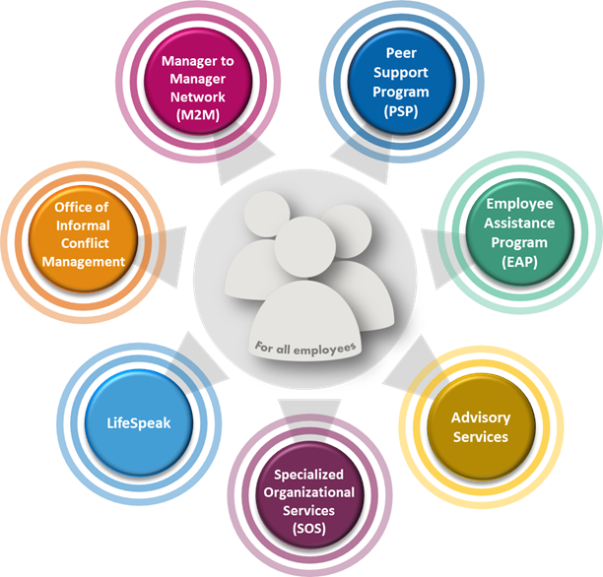
SERVICES TO ASSIST YOU!
Notes:
Other than the EAP and the PSP, there are more resources to assist you in the department.
Visit SERVICES TO ASSIST YOU under the Workplace Mental Health site on iService.
By clicking on each of the circles, you will obtain information about each of the services.
Some of the services offered are online while others are in person.
IF YOU ARE COMFORTABLE AND TIME PERMITING: you can click on the hyperlink and show services.
QUESTION PERIOD.
THANK YOU

