Slide 1
A Shared Path Towards Mental Health in the Workplace
An overview of the ESDC Integrated Framework on Mental Health in the Workplace (2015)

Slide 2
Objectives
To address:
What is Mental Health?
How does it relate to the workplace?
How is ESDC approaching it?
What’s in it for you?
What can you do to support a psychologically safe and open organizational culture?
Stigma
But most of all, the idea today is to start talking about mental health at work and trigger continued discussions in your team!

Slide 3
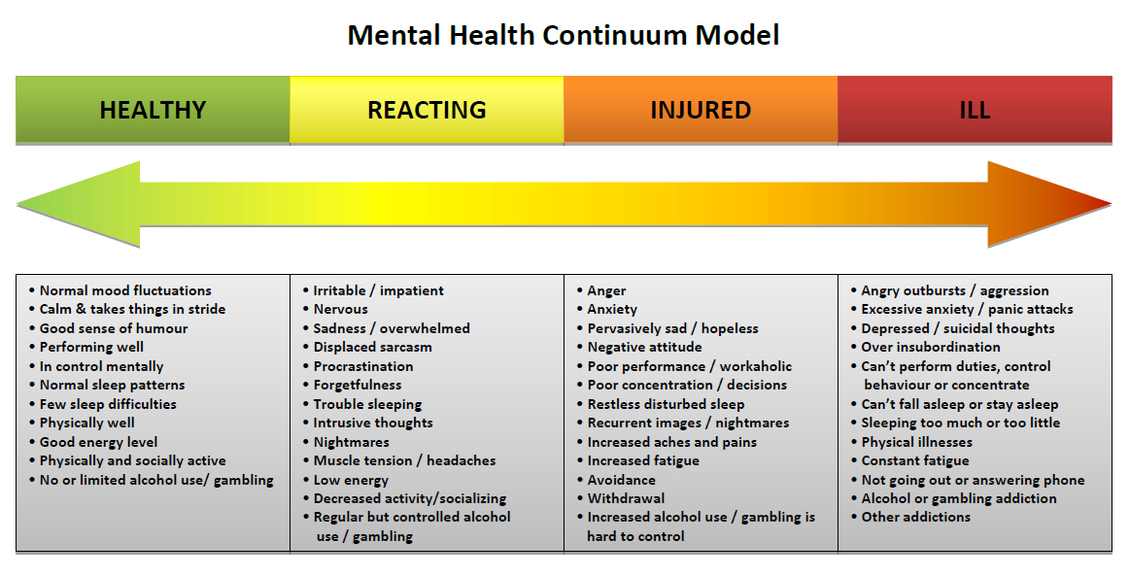
What is Mental Health?
Mental health and mental illness are not synonyms.
Mental illness is a state of mental health.
Addressing mental health is not only about dealing with mental illness.
The same way we all have a state of physical health, we all have a state of mental health.
What is my state of mental health today?

Slide 4
Mental health problems and mental illness impact everyone in Canada…
Within ESDC, 49% of disability claims are related to a mental health problems or illnesses.
¹ Sairanen, S., Matzanka, D., & Smeall, D. (2011). The business case: Collaborating to heal employees maintin their mental well-being. Healthcare Papers, 11, 78-84.
² Smetaning, P., Stiff, d., Briante, C., Adair, C., Ahmad, S., & Khan, M. (2011). The life and economic impact of major mental illnesses in Canada: 2011 to 2014. RiskAnalytica, on behalf of the Mental Health Commission of Canada.
³ Ibid.

Slide 5
How does it relate to the workplace?
Trying to maintain health, including mental health, is a delicate balance that many factors can influence - workplace, family environment, financial situation and other life circumstances.
Ineffective workplace practices can contribute to illness. Employers therefore can influence mental health.
However, health is primarily everyone’s responsibility and organizations cannot be expected to take ownership of employees’ health.
The workplace is a community, where everyone – regardless of their level - can support one another to maintain good health, feel supported to participate fully, and to be able to better manage life’s challenges.

Slide 6
The Canadian Context
2013: Launch of the voluntary « National Standard of Canada for Psychological Health and Safety in the Workplace »
The Standard details elements of a workplace culture that can positively or negatively impact our mental health.

Slide 7
On the Radar of the Federal Public Service
The current Clerk of the Privy Office and his predecessor have both identified mental health at work as a corporate priority for the public service.
In March 2015, Treasury Board Secretariat (TBS) and the Public Service Alliance of Canada established a Joint Task Force to address mental health issues in the public service.
In July 2016 TBS launches consultations with public servants on a government-wide Mental Health Strategy.
Momentum continues towards building higher performing organizations through Blueprint 2020.
“Create a Culture of Humanity, Compassion, and Fairness”

Slide 8
What has been done at ESDC?
December 2014: Corporate Management Committee approved the development of an Integrated Framework on Mental Health in the Workplace and tasked the development of a three-year action plan from 2015 to 2018.
The Framework was launched in May 2015.
ESDC Executives have objectives related to workplace mental health in their Performance Agreements.

Slide 9
How was the Framework developed?
Established a Steering Committee:
Co-chaired by two Assistant Deputy Ministers
Participation of employees, managers and executives from across the organization with support from human resources
Educated ourselves:
Public Service Employee Survey Results/APEX EX Survey on Mental Health, and other research
Studied the Standard to guide the development of the Framework
Researched best practices across public and private sectors
Consulted Key Stakeholders:
Employees
Managers
Bargaining Agents

Slide 10
What areas need attention?
Better understanding of what mental health is, to eliminate the stigma (i.e. not just about mental illness)
Self-awareness of how to care for our own mental health
Cultural perception of asking for help (i.e. seen as a weakness)
Skills and confidence to offer help to a co-worker who seems to struggle
Readiness of employees as they move into manager roles, especially from a people skills perspective
Managers’ abilities for early detection and supportive resolution of workplace issues
Training for all employees and specialized learning opportunities for managers and executives

Slide 11
ESDC’s Integrated Mental Health Framework
The Framework establishes a vision for ESDC to be a workplace that promotes psychological health and safety and encourages employees and managers to address mental health concerns openly.
THE FRAMEWORK IS BASED ON THREE PILLARS
PROMOTE
PREVENT
RESOLVE
Promote understanding, awareness and acceptance.
Equip managers and executives to proactively support employees in maintaining good mental health and addressing mental health issues.
Build supportive mechanisms for employees and managers dealing with mental health challenges.
OUR EXPECTED OUTCOMES
Employees of all levels can identify and recognize their own stress levels and stressors, and know how and where to seek help.
Managers can respond to mental health issues and support employees.
Executives support recovery to keep healthy people at work, and to facilitate return to work.
The stigma of seeking help or discussing mental health issues is reduced among managers and employees.

Slide 12
Elements of a Healthy Workplace
The Framework identifies five workplace factors that influence - positively or negatively - our organizational culture:
EMPLOYEE ENGAGEMENT AND DEVELOPMENT
HEALTH AND SAFETY IN THE WORKPLACE
WORK CONTENT AND CHARACTERISTICS
CLEAR LEADERSHIP DIRECTION
SUPPORT
AND
BALANCE
ORGANIZATIONAL CULTURE
CREATING AN ORGANIZATIONAL CULTURE THAT SUPPORTS MENTAL HEALTH IN THE WORKPLACE IS A SHARED RESPONSIBILITY
Regardless of where we are in the organization, we influence our culture. The question is: Do we do so positively or negatively?

Slide 13
Three-Year Action Plan: Activities Highlights
Promote understanding, awareness and acceptance
Develop a menu of learning options
Provide self-serve resources and tools
Enhance coaching for resolving conflict when a mental health issue is at play
Develop forum to share managerial best practices and gain support (Action Learning)
Leverage and promote Employee Assistance Program-Manager Advisory services to access experts in mental health
Equip managers to proactively:
support employees in maintaining good mental health
address mental health issues that present at work

Slide 14
Three-Year Action Plan: Activities Highlights (cont’d)
Proactively identify occupations at higher risk of exposure to psychological hazards and implement measures to reduce and address exposure
Focus on Occupational Health and Safety
Empower our Workforce:
Assist employees to better recognize how they can take care of themselves
Assist those who are sporadically absent from the workplace due to episodic illness, or returning to work after a period of illness
Deliver Personal Resilience Workshops
Peer Support initiatives: Supportive networks between people who have a lived experience
Enhancing understanding of Duty to Accommodate, return to work planning, and improve human resources integrated advisory services for managers

Slide 15
Highlights of Action Plan Deliverables: What was done so far?
Created an Implementation Working Group comprised of managers, employees and human resources professionals to advance the Action Plan deliverables.
Chaired by Sara Filbee, Assistant Deputy Minister, Service Canada, Atlantic Region and Champion for Mental Health
Supported by Lori Sterling, Deputy Minister of Labour Program and Mental Health Sponsor
Dedicated an iService section to Mental Health in the Workplace
Built a menu of learning opportunities for employees, managers and executives on Mental Health through online self-directed learning and classroom
Published the Mental Health Passport
Published articles, blogs and produced a video…
…and much more is coming!

Slide 16
How can you get involved?
Lead by example through self-care
What is my state of mental health today?
Which workplace mental health factor can I influence today?

Slide 17
How can you get involved? (cont’d)
If you feel comfortable, discuss concerns you may have with your manager to see what they might be able to support you with (e.g. adjusting your workload, better ensuring your safety at work, offer operationally feasible alternate work arrangements, etc.).
Take advantage of the Office of Informal Conflict Management services to prepare for sensitive discussions with a colleague or supervisor, or suggest that their services be enlisted to facilitate the actual discussion.
Ask for help!
Reaching out for support is not weak: it’s courageous!

Slide 18
How can you get involved? (cont’d)
Call upon Employee Assistance Program services to gain some insight on difficult situations that occur in your personal life or at work and become better equipped to deal with them in a healthy way.
Take advantage of mental health-related learning opportunities by discussing your learning plan with your manager – see iservice.prv/MentalHealth for an up-to-date list of opportunities.
Implement what you learn in your everyday work and be a change agent!
Learn!

Slide 19
How can you get involved? (cont’d)
Do you automatically erase incoming Intersection and CommsCorporate emails?
Many of us do that…
but we are missing out!
Look out for mental related-health communiqués:
they might be helpful to you or someone you know!

Slide 20
But most of all…TALK ABOUT IT!

Slide 21
For information or feedback, you can contact
the Implementation Committee at:
NA-MH_WORKSHOP-ATELIER_SM-GD

