Slide 1
PayPal WebEx
Information Session on
PayPal Best Practices
Notes:
Today we will be discussing the use of PayPal to process acquisition card transactions. You can refer to the Procurement Bulleting from November 15, 2016, named “Acquisition Cards and the use of PayPal”, as a tool to help guide you through the revised internet purchases process for PayPal. You can locate this bulletin on the iService webpage. You can scroll through the iService Catalogue, click on Acquisition Card, and then select the Acquisition Card Program. On the left hand side of the screen, you’ll see Procurement Bulletins. Click on that link and you will be able to find the procurement bulleting mentioned previously.
http://iservice.prv/eng/index.shtml
http://iservice.prv/eng/finance/purchasing/docs/Bulletin_2016_7.pdf
http://iservice.prv/eng/finance/purchasing/procurement_bulletins.shtml

Slide 2
AGENDA
PayPal Facts
PayPal Monitoring
Cardholder Responsibilities
Manager Responsibilities
Using PayPal as a Last Resort – a Step-by-Step Guide
Questions?
Valid and Invalid PayPal Justifications
Notes:
Our agenda for today’s WebEx is the following:
We will be going over some PayPal Facts and the revised acquisition card processes surrounding the use of PayPal
We will be sharing with you the PayPal Monitoring procedure, as well as both cardholder and manager responsibilities in regards to PayPal
We will also be providing you with a recap of the revised acquisition card process accompanied by a step-by-step guide of using PayPal as a last resort
And lastly, we will be reviewing examples of what would be considered valid and invalid justifications for the use of PayPal
Please hold your questions until the end of the presentation where we will gladly answer any questions or concerns you may have

Slide 3
PayPal Facts
PSPC revisions to the Receiver General Manual, “Government of Canada Acquisition Card Program” regarding the use of PayPal
Every PayPal transaction requires supporting documentation and justification
NEW
Supporting Documentation Includes:
Comprehensive description of the purchase and how it was necessary to meet operational requirements
A detailed record of the steps taken to find another qualified vendor who accepts the acquisition card directly
Notes:
As stated in the Procurement Bulletin from November 15th, PSPC has made revisions to the Receiver General Manual for Chapter 9 “Government of Canada Acquisition Card Program” regarding internet purchases and the use of PayPal.
ESDC currently allows acquisition cardholders to use PayPal, with the exception that every PayPal transaction has supporting documentation and justification for the purchase.
Supporting documentation includes:
A comprehensive description of the purchase and how it was necessary to meet operational requirements
In addition to a detailed record of the steps taken to find another qualified vendor who accepts the acquisition card directly, and not through the use of PayPal

Slide 4
PayPal Facts Continued
PayPal is considered high-risk for audits and data mining screening
ESDC currently allows acquisition cardholders to use PayPal and monitors 100% of these transactions
The Government of Canada does not have contractual agreements with PayPal
Cardholders must not register the acquisition card with PayPal
Notes:
As previously mentioned, ESDC currently allows acquisition cardholders to use PayPal and monitors 100% of these transactions.
PayPal transactions are considered to be high-risk for both audits and data mining screening.
Furthermore, the Government of Canada does not have any contractual agreements with PayPal.
Vendors that use PayPal also have the ability to mask the actual merchant or vendor, and payments could be made to possible counterfeit operations and other questionable merchants.
It is important to note that cardholders must not register an account through PayPal, in other words, do not create a PayPal account. If you have a registered PayPal account with the government acquisition card, please delete it immediately.

Slide 5
PayPal Monitoring
Invoices
Providing sufficient details, including company number and tax info.
Documentation
Demonstrating attempts to find vendor that accepts AC card directly
Justification
The good or service is unique and no other vendor offers it
PayPal transactions require:
Notes:
As you know by now, ESDC monitors 100% of PayPal transactions, and, as part of the ongoing management of the Acquisition Card Program, PayPal transactions are reviewed on a regular basis to ensure compliance with Government Procedures.
All PayPal transactions will now require invoices, as well as documentation and justification demonstrating that the cardholder has made every attempt to find a vendor who accepts the Government acquisition card directly before using a vendor who requires payment through PayPal. We will be sharing with you examples of justifications at the end of our session.

Slide 6
Cardholder Responsibilities
1
2
3
Contact company for details missing on invoice
4
Make every attempt to find a Government acquisition card accepting merchant
Must not register acquisition card or create account with PayPal
Ensuring supporting documents identify business with which transaction was done
Notes:
The following is a list of your responsibilities as a cardholder:
Where it is identified that the purchase will be processed via PayPal, the cardholder must make every attempt to find a Government acquisition card accepting merchant or vendor from which to procure the goods or services.
The cardholder is also responsible for ensuring that the supporting documentation clearly identifies the business with which the transaction was done.
If the invoice does not provide sufficient information, they should contact the company and ask for details, such as the company number and taxation information, and clearly identify this information on the supporting documentation.
As previously mentioned, Acquisition card holders must not register the acquisition card with PayPal.

Slide 7
Manager Responsibilities
1
2
3
4
Authorize use of PayPal
Certify that merchant is trusted
Certify PayPal was unavoidable
Review purchases not known as using PayPal
Notes:
The manager’s responsibilities are as follows:
When it is still found necessary to procure using PayPal, the manager can authorize the use of PayPal if they can certify without a doubt that the merchant is absolutely trusted and that the use of PayPal was unavoidable.
In the case of a purchase and payment which was not necessarily known as using PayPal, the manager must ensure that there is a detailed review of the purchase identifying the merchant/vendor name and code, and make sure the department has received the goods or services, and that the transaction was made in an efficient way.
An example of this is when the cardholder asks the vendor BEFORE the purchase if they accept the acquisition card directly and the vendor confirms that they do, however, once the invoice is received, the only method of payment accepted is PayPal. This is why it is important to clarify with the vendor that they indeed accept the acquisition card DIRECTLY, and not through the use of PayPal.
it is the cardholders responsibility to share information regarding the acquisition card processes with their managers and anyone else who may be affected.

Slide 8
Using PayPal as a Last Resort – a Step-by-Step Guide
Confirm vendor accepts the acquisition card DIRECTLY prior to making purchase
Make every attempt to find a Government acquisition card accepting merchant if the vendor only accepts PayPal
PayPal may be used if the merchant is absolutely trusted and the use of PayPal was unavoidable
Maintain supporting documentation that requirement is unique and can only be fulfilled by that vendor
STEP 1
STEP 2
STEP 3
STEP 4
Notes:
Here is a quick reference guide with step-by-step instructions on the use of PayPal as a last resort:
The first step is to confirm with the vendor BEFORE making a purchase that they accept the acquisition card DIRECTLY (and not through PayPal)
For the second step, if the vendor only accepts PayPal, the card holder must first make every attempt to find a Government acquisition card accepting merchant or vendor from which to procure the goods or services.
For the third step, if there are no other qualified vendors and the requirement is unique, PayPal may be used for the purchase if the merchant is absolutely trusted and the use of PayPal was unavoidable
The fourth and last step is for the cardholder to maintain a record of adequate supporting documentation and justification showing that the requirement is unique and can only be fulfilled by that vendor

Slide 9
Examples of Valid and Invalid Justifications
Valid Justifications:
Invalid Justifications:
THCEE form
Return supplier
Lack of communication
Lowest bidder
Expert on the matter
Notes:
Now I will be sharing with you some examples of what are considered valid and invalid justifications for the use of PayPal.
To begin, here are some scenarios in which the use of PayPal is justifiable:
Scenario #1. A PayPal transaction can be justified if there is a substantial cost difference between other vendors and the initial vendor who only accepts payments through PayPal for the same product or service. Therefore, if all of the other vendors have provided much higher bids for your requirement than the initial vendor, the risks associated with PayPal are acceptable and justifiable. In summary, if Vendor A provided you with a quote for $1,000, and Vendors B, C and D all quoted $1,500 and over, Vendor A would be selected even though they only accept PayPal because the good or service provided by this vendor costs $500 less than the other options. You can provide us with this justification in writing, as well as all of the quotes submitted as documentation.
Scenario #2. Another example of a valid justification for the use of PayPal is if you require an expert in a specific field, or on a specific matter, to speak at an event or conference and they only accept the acquisition card through PayPal. These experts are often unique and there are no other experts in the area who could provide the same service. Therefore, this type of transaction would be justifiable, and you would be required to provide this information to us in writing, in addition to the quote for the service.
Now, here are some examples of invalid justifications for the use of PayPal:
Scenario #1. This is something we often receive as a response to our PayPal monitoring emails, which is the THCEE form. Please do not send us the THCEE form sign by the Senior Assistance Deputy Minister, as this form applies to travel, hospitality, conference and event expenses procedures, and is not applicable to the PayPal transaction procedure. You must provide us with details, in writing, as to which steps you took to find another vendor who accepts the acquisition card directly, as well as any documentation, such as quotes or email communication from the other vendors.
Scenario #2. Another example of an invalid justification would be if you have previously received goods or services from a particular vendor in the past, and you had a positive experience using that vendor. Therefore you would like to select this vendor once more, but they only accept payments through PayPal. The procedure for the use of PayPal has changed, and, unfortunately, clients can no longer select a vendor who was chosen in the past but only accepts PayPal as a method of payment, when other vendors can offer the same product or service and accept the acquisition card directly. In this scenario, the vendor who accepts the card directly must be selected, unless another vendor can provide the same product or service for a significantly lower price.
Scenario #3. Lastly, another common response that we receive during the monitoring of PayPal transactions is when cardholders receive invoices from clients after the services have been rendered or the products have been received, and that the vendor requires payment through PayPal. The justification in this scenario is not acceptable. When a cardholder pays an invoice for a client, they must be in line with the procedures that govern the use of the acquisition card. If a client asks the cardholder to pay an invoice that contradicts these procedures, the cardholder is put in a difficult situation, but cardholders still have to follow the rules in regards to the use of PayPal. If a cardholder pays an invoice for a client, they must ensure that their clients are informed and that they understand that there are limits associated with the use of the departmental acquisition card. The cardholder is primarily responsible for complying with the Department's procedures when using the acquisition card.

Slide 10
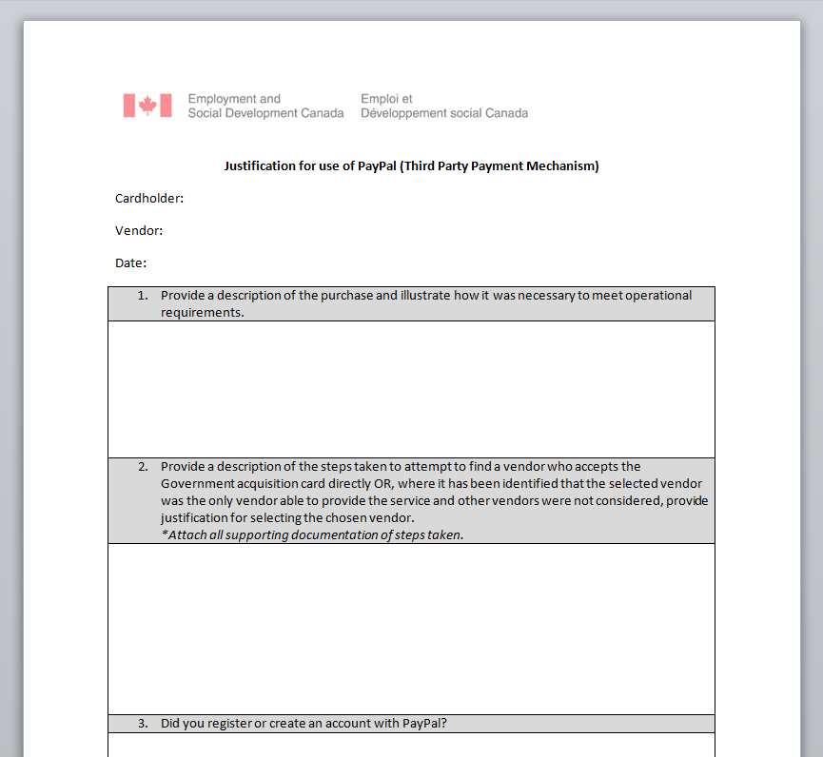
Justification for use of PayPal
Notes:
In the next few days, we will be sharing with you a form that will be a good tool to guide you and to help us with the monitoring of PayPal transactions. You can fill out this form the day you process the PayPal transaction, or at the end of the month, and it will be your justification once you receive our monitoring emails. In addition to the form, you are also required to provide us with all applicable quotes and the invoice.
To conclude, if you are not sure that your justification is valid, or if you have any questions, you can contact us through the NC-PURCHASING-PORTAL at any time and it would be our pleasure to assist you.

Slide 11
Who do I contact for…?
NC-PURCHASING_PORTAL-PORTAIL_D'ACHATS-GD
Questions about procurement, obtaining a card, change of Manager/Cost Centre, changes to your Payment Card Master Record in SAP, canceling a card, resetting your password and/or memorable word for VISM website, etc…
‘Report an Incident’ in myEMS portal
Creation of card documents (ex. CRK1, CRK2)
Contact the National Accounting Operations via iService or by phone at 1-855-684-7827 (option #3)
Submission of your statement
Account reconciliation
Unaccepted transactions (ex. ZZCR, ZZCCVR, ZZCCAR) of your card document monthly statement
* Please note: do NOT write to NC-CARTEDACHAT-VISA-ACQUISITIONCARD-GD as this address exists solely to provide information to cardholders from Accounts Payable.
Notes:
It isn’t always easy to know where to turn for information concerning the acquisition card. This page might also be a good one to print and keep around as a reference.
Essentially,
If you are looking for information concerning the procedures surrounding requests to obtain or cancel an acquisition card, to change information linked to your acquisition card account, such as your cost center, manager information, mailing address, temporary increases, etc., or if you are looking for information concerning the policies related to the use of the acquisition card, please communicate with us by writing to the purchasing portal.
If you are looking for information regarding card documents, you can report an incident via the (myEMS) SAP portal.
If you are looking for information regarding your monthly reconciliation, you can communicate directly with National Accounting Operations.
Also, please note that you receive an email every month concerning your monthly reconciliation from the NC-CARTEDACHAT-VISA-ACQUISITIONCARD-GD. This email address solely exists to provide information to cardholders from Accounts Payable, therefore please do not email this account in regards to the acquisition card.

Slide 12
Questions?
Notes:
So we are now concluding our PayPal WebEx and before we invite you to ask questions regarding PayPal, we would like to inform you that we will be giving another WebEx session regarding general information and frequently asked questions on the acquisition card program in the fall. We would like to hear some feedback on topics that you would like us to discuss in that presentation. You can send us this information to our NC-PURCHASING PORTAL email.
Thank you for participating in today’s WebEx, I will now open up the floor to your questions about PayPal!

