Slide 1
Human Resources Business Systems
HRSC Web Application
Lite Project 4.9
HR Presentation
December 2019

Slide 2
Table of Content
Introduction
Changes Affecting Clients
Adding and Saving Contracts and Documents
Contract Generation
Return of Signed Documents in Place of Client
Transfer a Request with HR keywords
Generating a selection process number
Changing the type of request (staffing actions)
Various changes
Corrected Bugs
What’s next? Contact points

Slide 3
Introduction
This portal update project was undertaken to launch new functions and to improve User experience within the HRSC web application.
This presentation lays out changes you will notice beginning on January 17, 2020.

Slide 4
Changes affecting clients
Several improvements have been made for clients in this new version of the portal.
New way to access some staffing forms on the homepage.
Adjustment of certain features in the "My Requests" screen.
Added a Pop-up telling the client whether or not they have met the appropriate time frame in submitting their staffing request.
Creating a search tool for the "Selection Process Number" field.
Adjustments to how documents/contracts are added and saved.
Changes in the return of signed documents and the email generated.
Various updates to multiple forms (Separation Process, HR Reports, etc.).
We suggest you consult the presentation for client users to see the changes that affect them.

Slide 5
Adding and saving contracts and documents
The addition of documents will now be done in real time. It will no longer be necessary to confirm the action by clicking a button. Uploaded files will be private to HR by default and you will need to check the box to make them visible to the client.
Contracts will be added with the Signature required box checked by default. If the document does not need to be returned by the client, the box will have to be manually unchecked.
It is now possible to download all the documents or contracts added to a request. In order to proceed you just need to Click “Download Zip” and then “save as” to save all attached documents or contracts in a compressed folder.

Slide 6
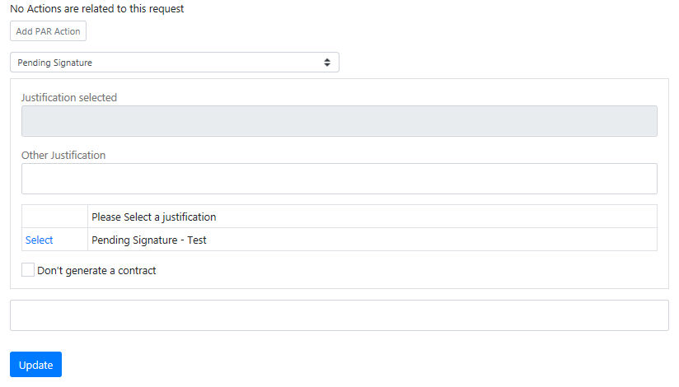
Contract generation
It will now be possible to prevent the system from generating contracts for the following actions:
Extension of student employment, casual and part-time worker, assignment, secondment into ESDC and acting appointment of less than 4 months. This feature is already available for the Term Extension Request form.
How to stop contract generation?
Click on the "Contracts” section and drag & drop or upload the documents that will replace the contract.
Change the status of the request to “Pending Signature."
Add your instructions and note as needed.
Check the box "Don't generate a contract.
Click "Update" and confirm your action.

Slide 7
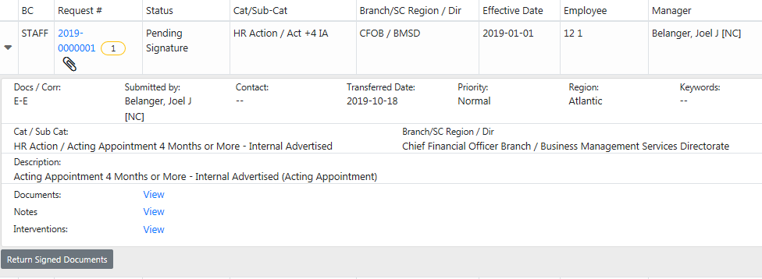
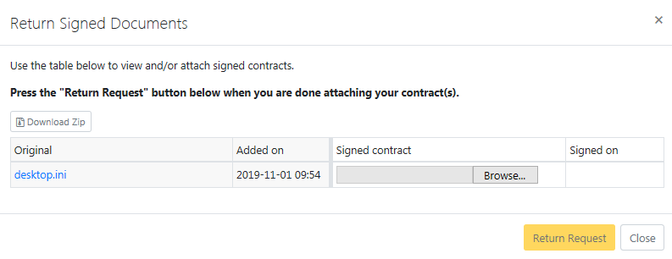
Return of signed documents on behalf of the client
We will have a new way to return signed documents & contracts in place of the client.
Here's the procedure:
In the "All Requests" screen, find the request and click on its line.
Click "Return signed documents”.
Upload a document in each location.
Click “Return request”.

Slide 8
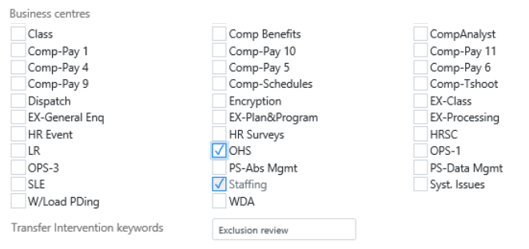
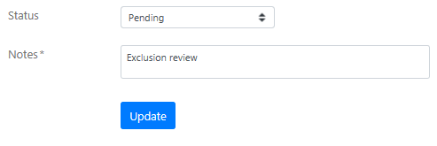
Transfer a request with HR keywords
When transferring an application, it will now be possible to identify an HR keyword that will quickly track a request in the Excel extraction feature.
Here are the steps:
Check the business centre where you want to transfer the request.
Insert the keyword into the "Keyword (intervention transfer)” field.
Change the status and insert a note as needed.
Update the request.
If you export new requests from the business center where the request was transferred, you will find the keyword in the AX column “Intervention Keywords."

Slide 9
Generating the selection process number
The Integrated Staffing Log (ISL) will be replaced as of January 17, 2020 with new feature.
Process numbers will be self-generated upon submission using the current year, the Department Code (CSD), the type of action (IA, EA, ACIN, INA, ENA), the region (ATL, WEST, NHQ, ON, QC) and the last 7 digits of the request number.
If the type of request, action or region needs to be changed, you will still be able to change the information on behalf of the client or return the request for change. Once the request is changed, the process number will be updated automatically.
New warning banners will appear at the top of the intervention when the process number is not found in the list of completed processes.
A new process management screen will be available to view data migrated from ISL and new data with the export to Excel feature.
This module will be used exclusively by EX-staffing and staffing teams, but a few groups will have access to the features. You will be contacted if you need to receive training on these new tools.

Slide 10
Change in the type of request (Staffing actions)
Clients and HR will now have the ability to change the type of request being processed for the following actions:
All term and indeterminate appointments, external and internal, advertised and non advertised may be reversed.
All acting appointments, less than 4 months and 4 months or more, may be reversed.
All Deployments, term and indeterminate, advertised and non advertised can be reversed.
Casual employment and part-time workers may be reversed.
Return the request to the client or click "Change” to change the type of request. Make sure you have the necessary information on hand as new fields may be required depending on the type chosen.
Reminder about the « Edit request » function
Give the status of a "modified" intervention to "Processing" to make the “Edit Request" button available again. This will allow you to update a request that had been returned by client with modification.

Slide 11
Various Changes
New Business Centres
We have created 15 new business centres. We will soon share the list of business centres with those responsible if you have any questions about their activities.
Compensation Business Centres
We added the features used by the compensation team to their existing business centers that didn't already have them.
6 of the 15 new business centres will be allocated to the compensation team.
Changes to Excel extractions
Converting Column D (Current Status Date) to Date Format.
Conversion of the AY column (Intervention Count) to the number format.
Added the selection process number field to the BC column.
History tab
A new note will be recorded in the request history when the category and subcategory are changed.

Slide 12
Bug Fixes
Contract not generated when sending for signature
The bug that returned the request to the client for signature without the auto-generated contract will be fixed with this release.
Separation Clearance
Two of the emails that were generated to the employee were no longer working. It will be corrected.
When the "Illness" departure type was selected, the email to the integrity groups and CFOB was not generated.
Effective date filters in “All Requests”
It will again be possible to filter the "All Requests" screen by the effective date.

Slide 13
What’s next? Contact us
Would you like to help us improve the functionality of the HRSC portal? We are already working to collect your requests for changes for future, lite projects in 2020. Don't hesitate to pass on your suggestions to your business centre's point of contact.
Have you encountered a technical problem with the portal, or are you having trouble or accessing it? Contact us at this address: NA-HRSC-CSRH-WEB-APP-GD

