Slide 1
Human Resources Business Systems
HRSC Web Application
Lite Project 4.9
Client Presentation
December 2019

Slide 2
Table of Content
Introduction
Changes to the home screen
Replacing the "My Requests" screen
Save as a draft or template
Submit as new / Cancel a request
Submitting HR actions in a timely manner
Selection process number
“Pending signature" requests
Adding and Saving documents/contracts
Separation Clearance Form
View date of status update
Changes to the forms
Changes to the drop-down menus of some fields
What's next? Contact us

Slide 3
Introduction
This portal update project was undertaken to launch new functions and to improve client-user experience within the HRSC web application.
This presentation lays out changes you will notice beginning on January 17, 2020.

Slide 4
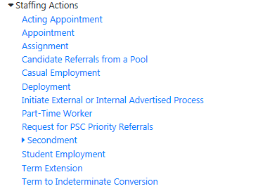
Changes to the home screen
The list of forms available for staffing actions has been re-organized.
All forms related to deployment are under the “Deployment” link
All indeterminate and term appointment forms are under the “Appointment" link.
All acting appointment forms are under the “Acting Appointment” link.
For each of these groups of forms, it will now be possible to change the type of request after it has been submitted. Just click on the "Change" link to the right of the form name.
A brand new form has been created for acting appointment of four (4) months or more - external advertised

Slide 5
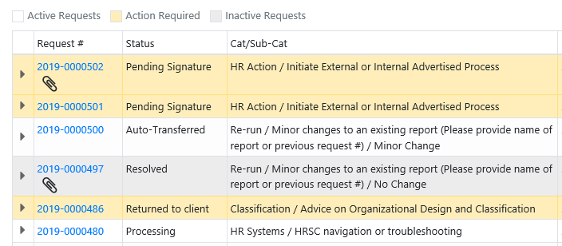
Replacing the “My Requests” screen
Some may have noticed that since the last release of the portal, a new "My Requests" screen is available. The old default screen will be retired.
A new color caption will be available in the list of requests:
White: Requests still active on the human resources side.
Yellow: Requests that are returned to you for action required (for modification or return of signed documents).
Grey: Requests resolved, cancelled or declined.
For more information on this new screen, please visit:
Client Reference Sheet - What's New in Version 4.8 of July 2019

Slide 6
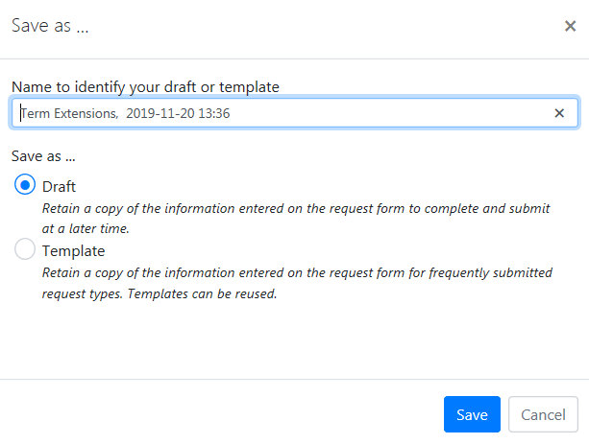
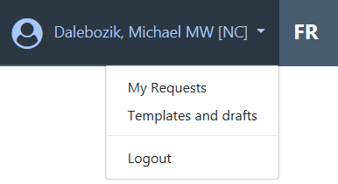
Save as draft or template
We have adjusted the way you save a request as a draft or template for future use. You will now have to click the "Save and Exit" button and then choose what type you want to “save as”.
Steps:
Once in the form you want to save, click "Save and Exit“.
Then select whether you want to save as a draft or as a template.
Reminder: You can retrieve your requests saved under your name from the top menu.

Slide 7
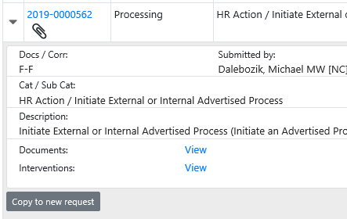
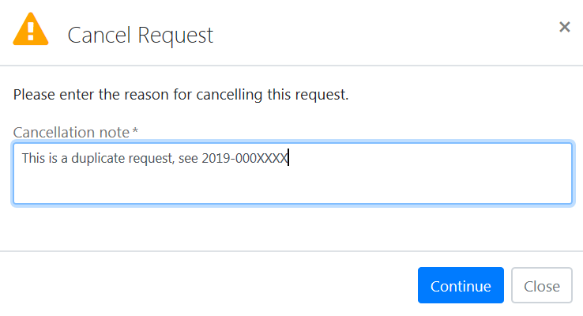
Submit as new / Cancel a request
The feature to retrieve an already submitted request and submit it as a new request has been moved and renamed.
From the "My Requests" screen, find the original request to copy and click the "Copy to New Request" button. Fill in the fields, upload the documents and click "Submit."
A client is able to cancel a request when their status is "New Request," “Auto-Transferred," "Assigned" or "Returned to Client." A new window will open to ask for a note explaining the reason for the cancellation.
No matter the current status of the request, you will still be able to use a request to copy it into a new one.

Slide 8
Submitting HR actions in a timely manner
In an effort to improve the submission of staffing actions in a timely manner, a message will appear when entering the effective date to inform the client if it meets the required deadline.
Staffing actions | Timeframe (working days)
Acting Appointments Casual Employment Deployments Part-Time Workers Secondment into ESDC Student Employment Term Extension | 27
External appointments (term and indeterminate) | 35
Internal appointments (term and indeterminate) | 40
Message when the deadline is not met:
Message when the deadline is met:
It is important to know that this new window does not affect your ability to submit a request. It's only used as an indication to help you understand when you meet the right deadlines or not.

Slide 9
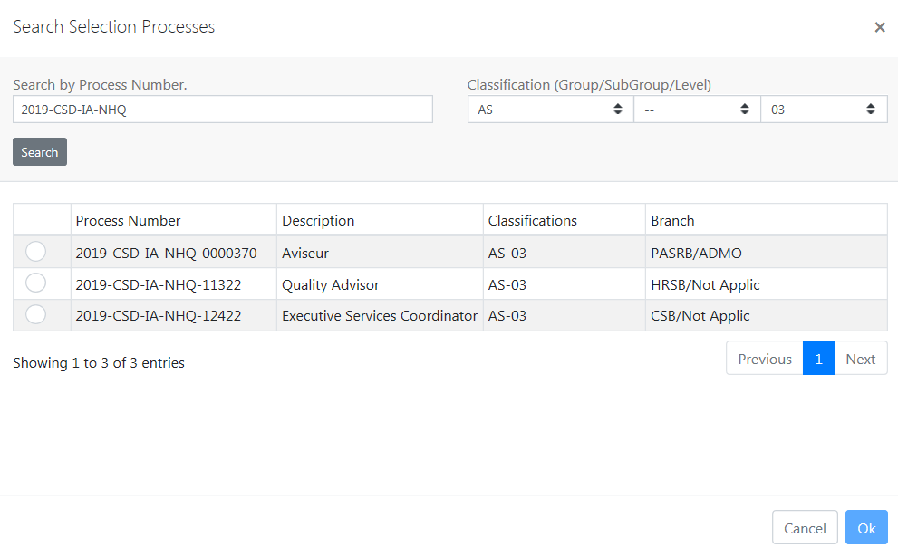
Selection Process Number
In order to reduce the number of HR tools, staffing process generation and management has been migrated to the portal. The selection process number will now be mandatory on some forms.
If you don't know the process number associated with the advertised appointment you want to make, you'll just have to tap "Click here to search for an advertised selection process initiated by ESDC." You can search by process number and classification.
If your process number comes from another department, you don't have to search for it, just insert it into the form's text box. The advisor will be informed that it’s from another department.
If the process number was issued by ESDC, but you are unable to locate it in the list, we suggest contacting your Human Resources advisor for assistance. Alternatively, you may indicate "unknown" in the field.
This change may bring adjustments to the procedures at a later date.

Slide 10
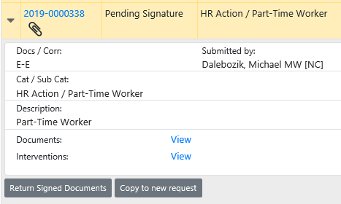
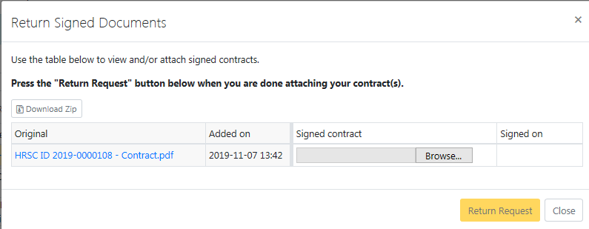
“Pending Signature” requests
IMPORTANT: For information security reasons, documents needing signature will no longer be attached to the automated “Pending for Signature" email.
Clients can now view the date they returned the signed documents.
A new button will allow you to return the signed documents to the "My Requests" screen.
Find the request with “Pending Signature" status
Click "Return signed documents"
Upload the documents
Click "Return the request".

Slide 11
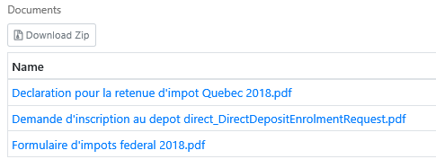
Adding and saving documents/contracts
Clients have the option to include documents in a request as long as it is closed (cancelled, declined or resolved) or in “Pending Signature" or "Signed Document" statuses. The addition will be made in real time without having to confirm the action. When the client leaves the screen, an automated email will be sent to the contacts, manager, submitter and HR staff assigned to the request (if applicable).
Clients will also have the ability to save all returned contracts and attached files into a compressed .zip folder. This will avoid having to repeat the action for each document separately.
Click Download Zip and decide if you want to open the folder or save in a location.

Slide 12
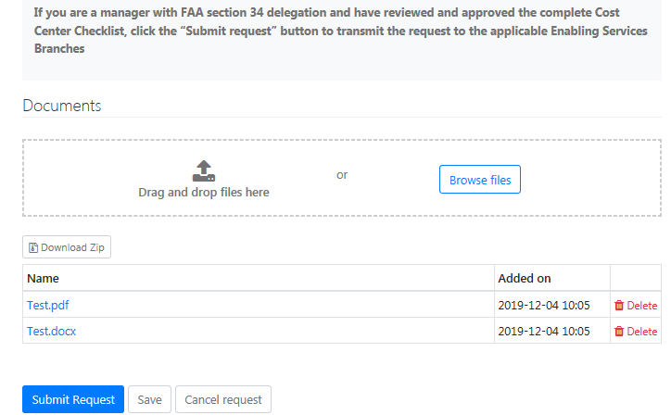
Separation Clearance Form
Some adjustments to the separation process include:
In order to finalize and submit the separation request, the manager or one of the contacts will now have to click the "Submit the request" button.
In order to save changes to a separation request without finalizing and submitting it, the manager, one of the other resource persons or the administrative assistant will have to click "Save“.
Since the last release of the portal, the administrative assistant has not been able to update the cost centre checklist. This problem will be corrected on January 17, 2020.

Slide 13
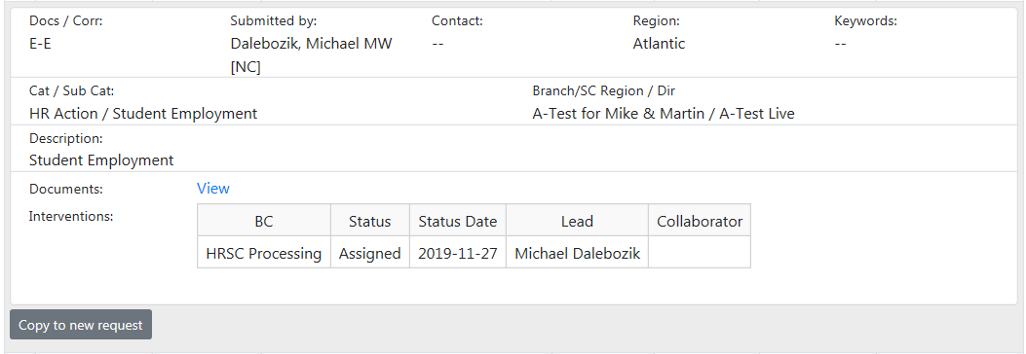
View date of status update
It will now be possible for clients to identify the date of the last status update of each of the business centers involved in a request.
Here are the steps to see the date of the last status change of a request:
Click on your name and then on "My Requests" in the top menu.
Find the request to view and click on its line.
Click on the "Interventions" link

Slide 14
Changes to the forms
PSC Priority Request Form
Added a question when the selected process type is “External Non-Advertised" or “Internal Non-Advertised"
Question when process type selected is External Non Advertised:
Question when process type selected is Internal Non Advertised:
Second language evaluation form
Added a question to determine if the employee's position is part of the executive group and added the telephone number field to the recipient's section of the invoice.

Slide 15
Changes to the forms (cont’d)
Secondment into ESDC
The work schedule fields were added to the form and contract and the compensation advisor information fields were retired.
Section added to the form:
Section removed to the form:
Update of Language Requirement of a position
Added Cost Centre (CC) to the form

Slide 16
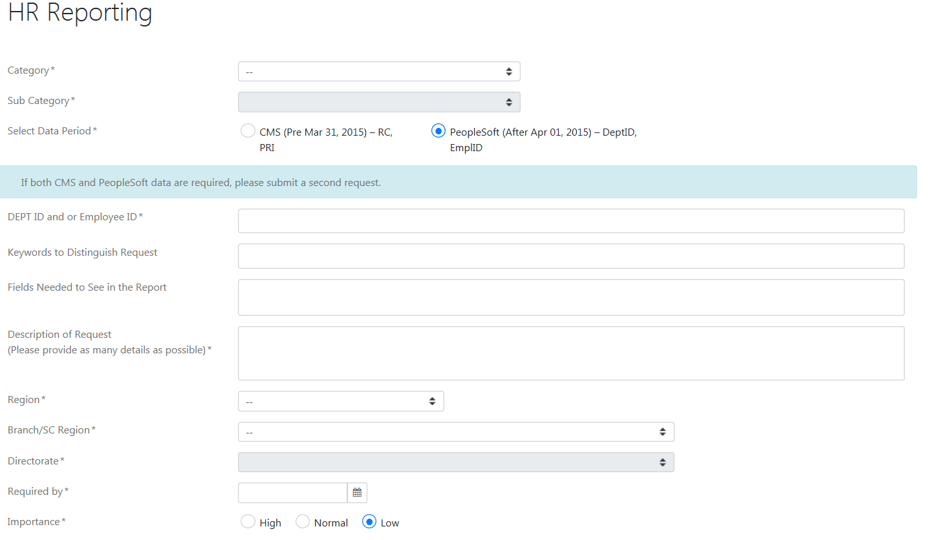
Changes to the forms (cont’d)
HR Reporting
The form was completely reviewed to allow you to provide more specific requirements for your report. New drop-down menus will allow you properly categorize your request.
Update Department & Review and Update of a position’s Job description forms
The old Location of work fields have been replaced by the Location Code field
Section added to the form:
Section removed on the form:

Slide 17
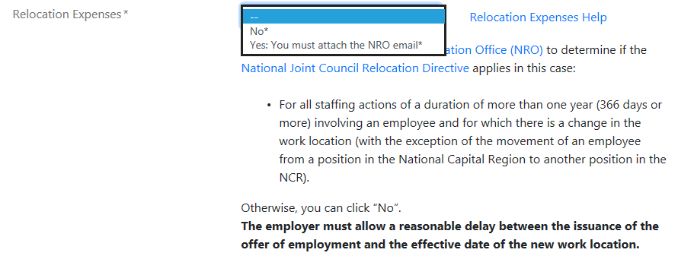
Changes to the forms (cont’d)
Position Language Requirement field
Added the "Reversible - English or French" option to the drop-down menu of several forms.
Relocation Expenses field
The drop-down menu options and additional information from this field has been updated for all forms.
Work Schedule field
A new option has been added to the Work Schedule field: "Fixed schedule outside normal hours."

Slide 18
What’s next? Contact us
Would you like to help us improve the functionality of the HRSC portal? Please share your suggestions with us using the General HR Enquiry form with the “HR Business Systems” category and the “Submit a Suggestion/enhancement on the HRSC Web Application” sub-category.
Have you encountered a technical problem with the portal, or are you having trouble or accessing it? Contact us at this address: NA-HRSC-CSRH-WEB-APP-GD

